Slide 1

Desktop Note Desktop application testing
Testing environment:
Windows 8.1, Version 6.3 (Build 9600) – VM
Windows 10 Home, Version 21H1 (OS Build 19043.1706)
Windows 11Pro, Version 21H2 (OS Build 22000.708)
Oracle VM VirtualBox 6.1, Version 6.1.34 r150636(Qt5.6.2)

Slide 2
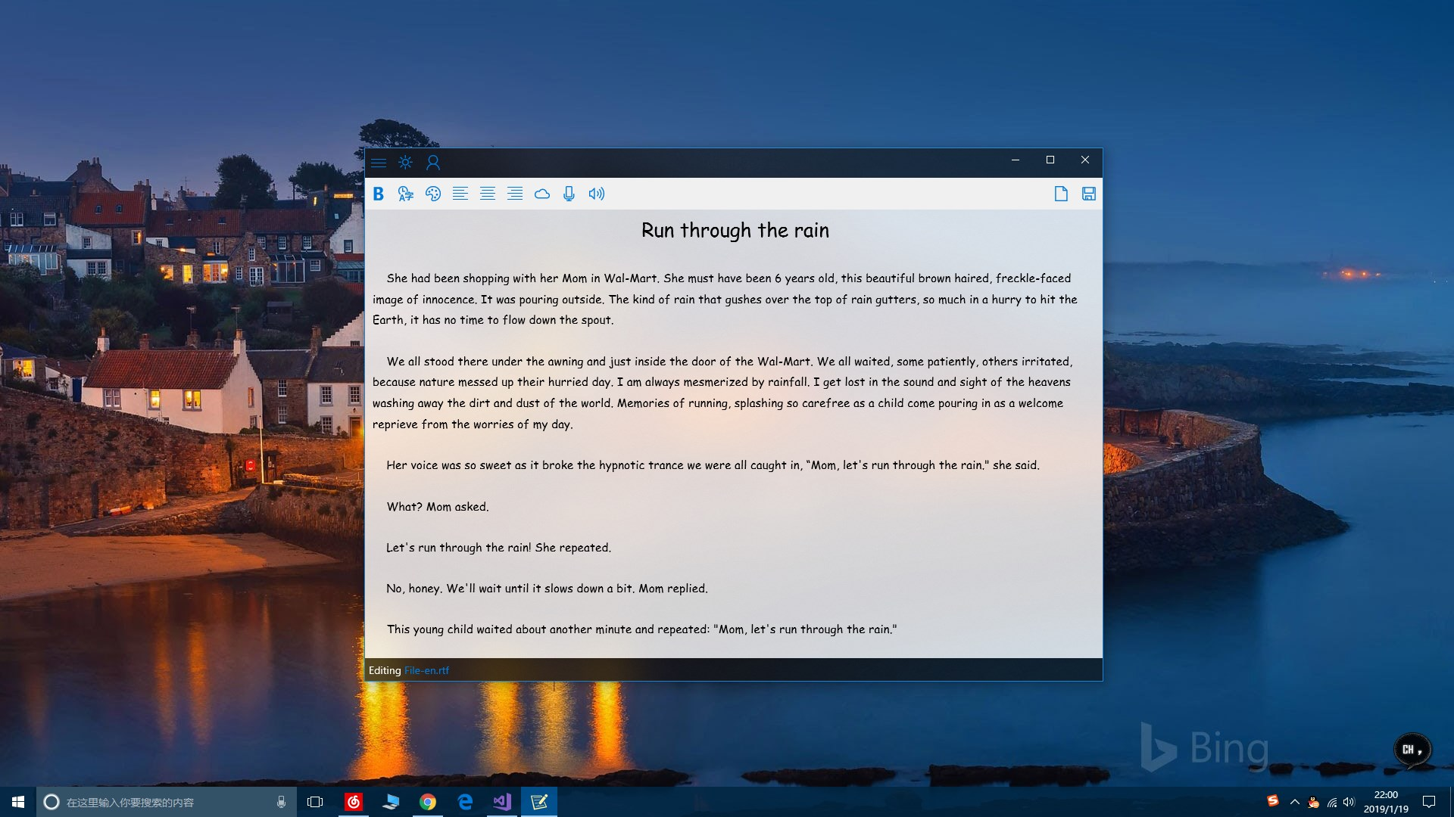
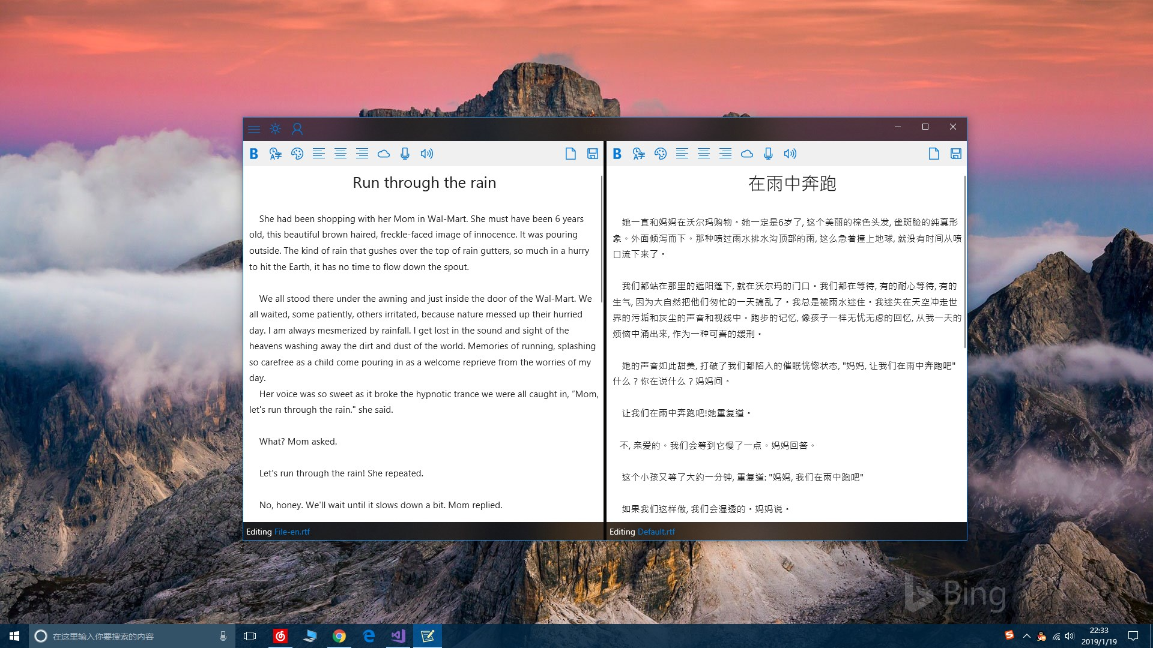
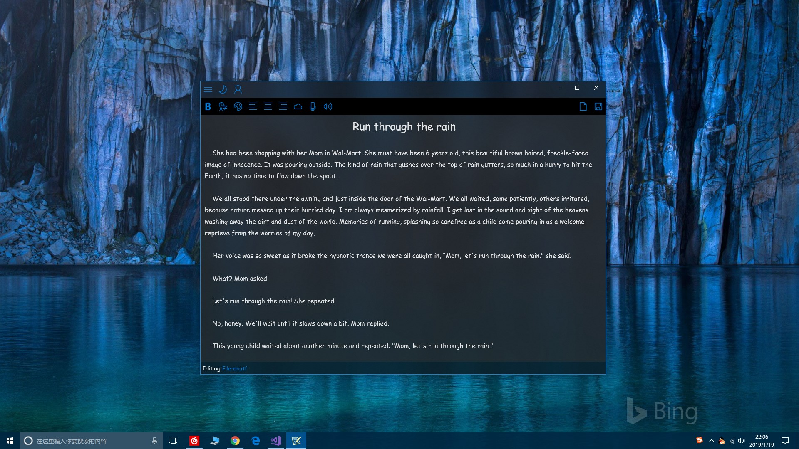
A super-useful desktop notebook created with concise design concept:
automatically save text while editing
automatically open the text of the last edit
automatically load the history edit list
support voice reading and speech recognition
conversion content through scanner to mobile phone
fast Alt+Ctrl+A calls
synchronization of cloud file upload and download
support txt, rtf
markdown text editing
support insertion of pictures/graffiti

Slide 3
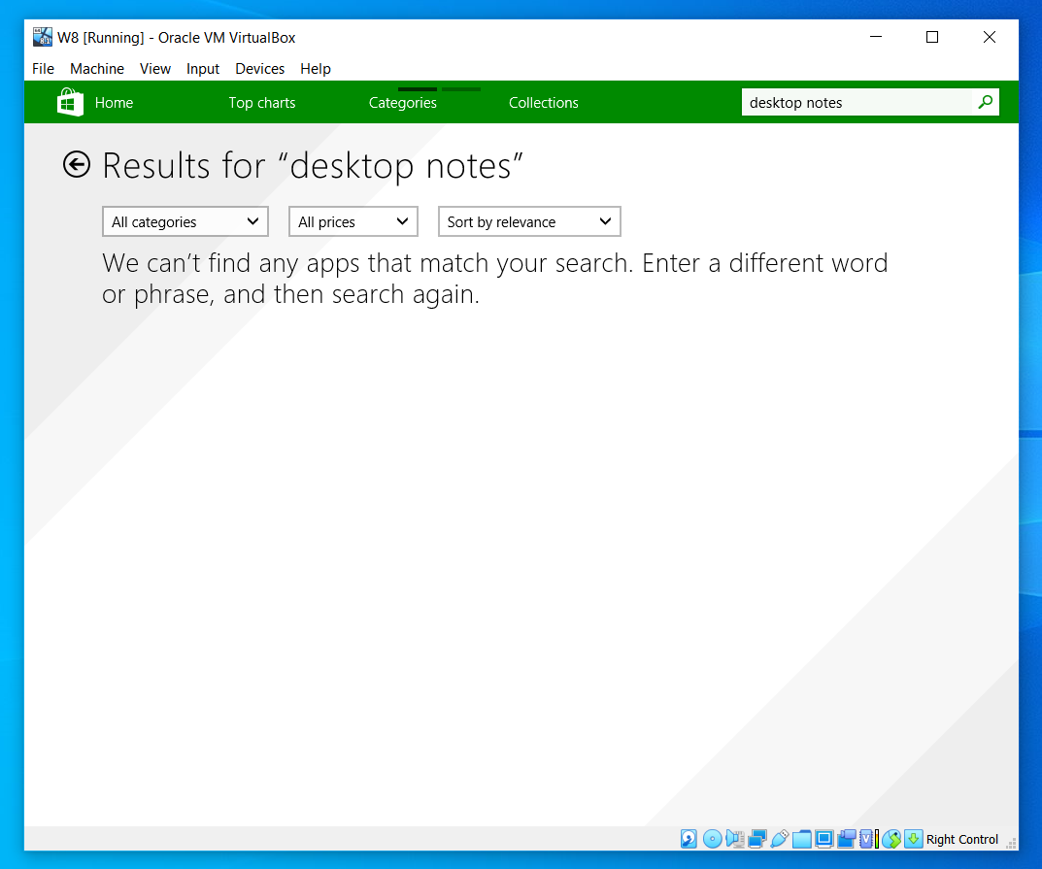
Summary (1) Result for Windows 8.1:

Slide 4
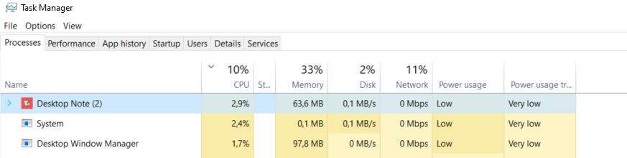
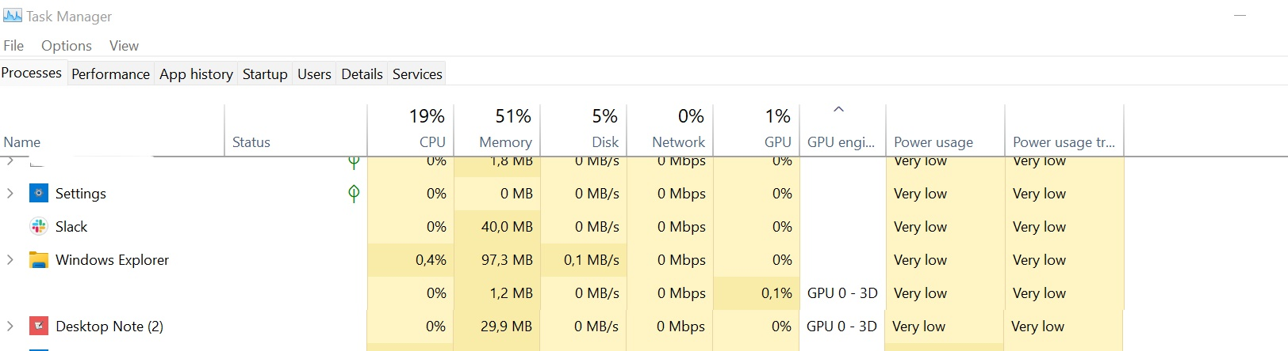
Summary (2)
Windows 10 Home:
Windows 11Pro:

Slide 5
Statistics
The results are different in different Windows operating systems:

Slide 6
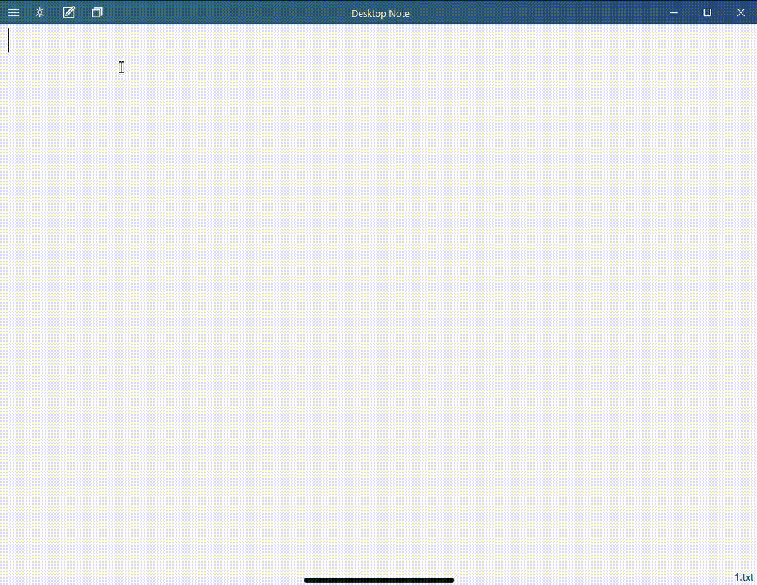
Bug, No.1 Translating the same text twice Only Windows 10 Home

Slide 7
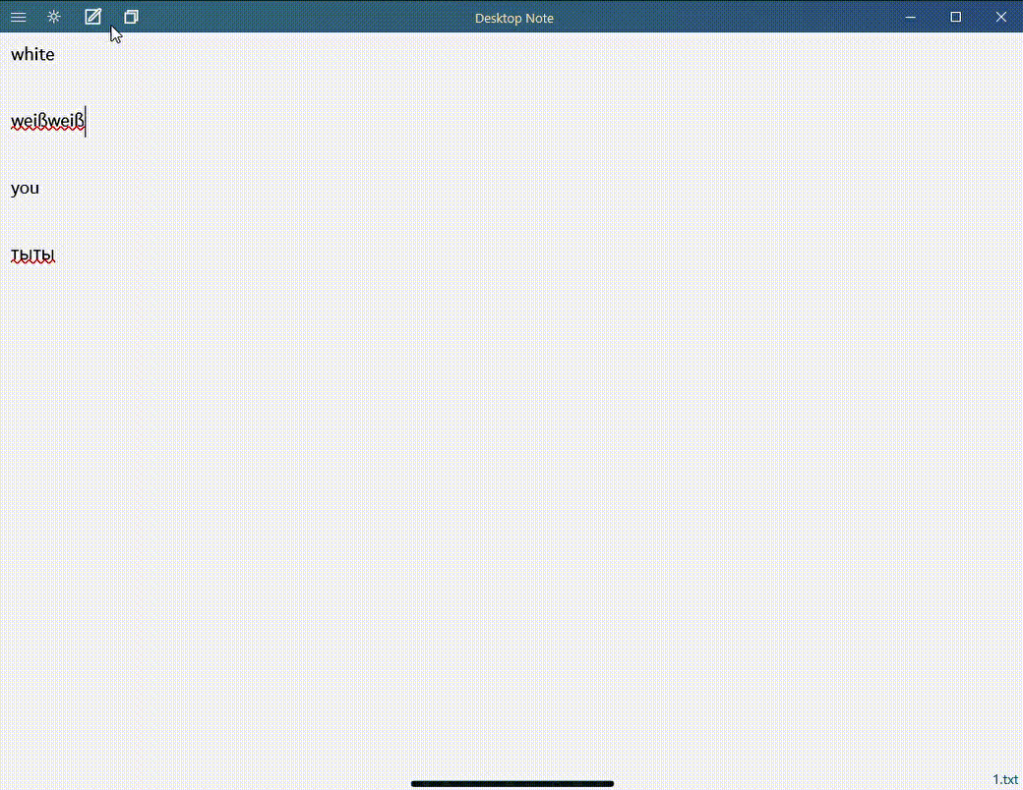
Bug, No.2 "Stick toolbox of editor" button not work Windows 10 Home, Windows 11Pro

Slide 8
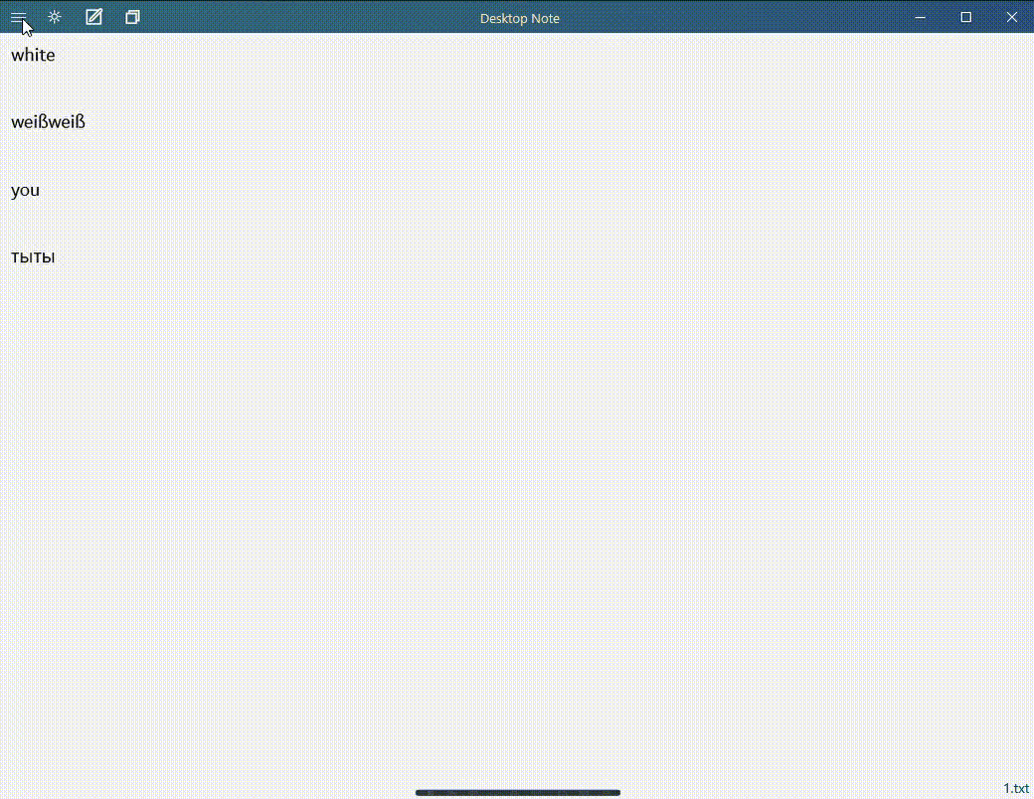
Bug, No.3 Transparent window color when created new file. Only Windows 10 Home

Slide 9
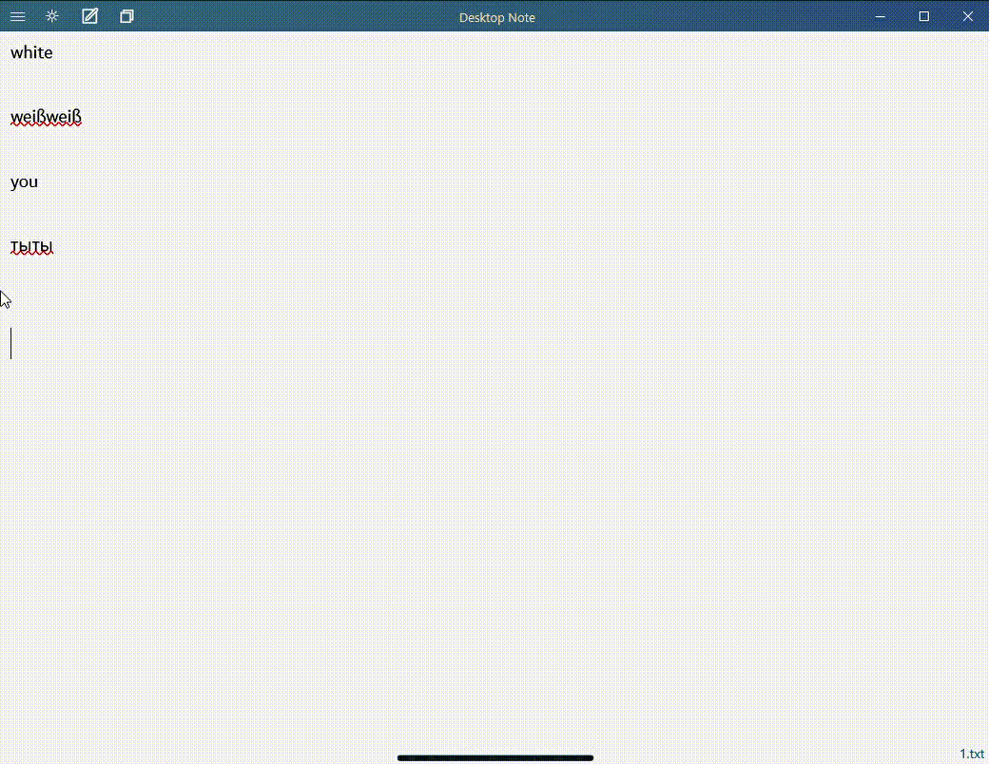
Bug, No.4 Black text on black window Only Windows 10 Home

Slide 10
What I liked in this application?
it is super easy to use
spell checker
automatically saved text

Slide 11
Thank You!

